Slide 1
Mechatronics (Merged - DEZG516/DMZG511/ESZG511)
Lecture

Slide 2
Session 7B
Type | Content Ref. | Topic Title | Study/HW Resource Reference
Pre CH
During CH | T1 | System modelling: Modelling of mechanical and electrical systems, Modelling of thermal and fluid systems | T1: Chapter 10
Post CH |  |  | Chapter end problems

Slide 3
System Modelling
A model is an abstract of the physical world
To understand the behaviour of systems, mathematical models are needed.

Slide 4
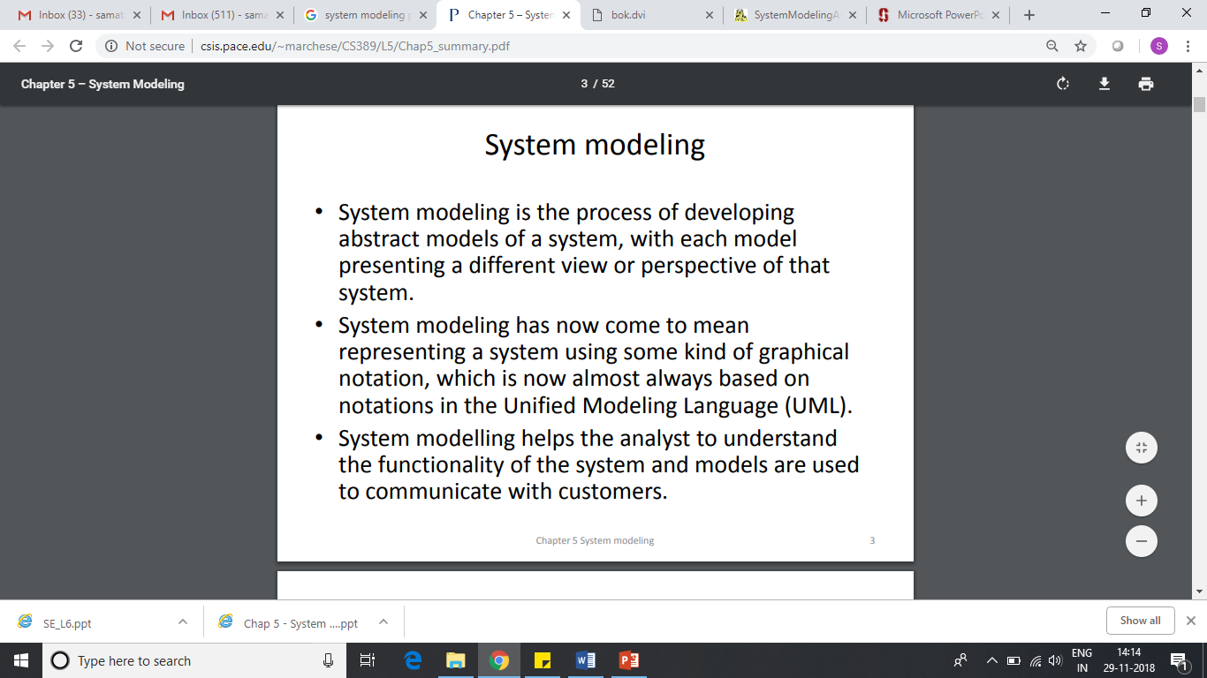
System Modelling
A model is created using equations to describe the relationship between the input and output of a system and can then be used to enable predictions to be made of the behaviour of a system under specific conditions.

Slide 5
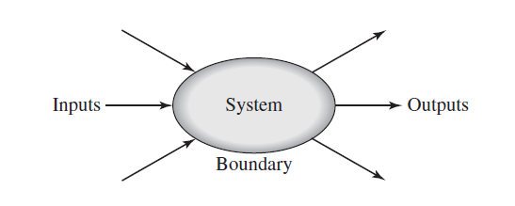
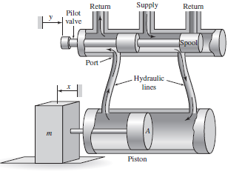
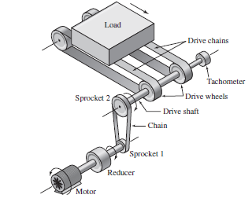
Input / Output concept

Slide 6
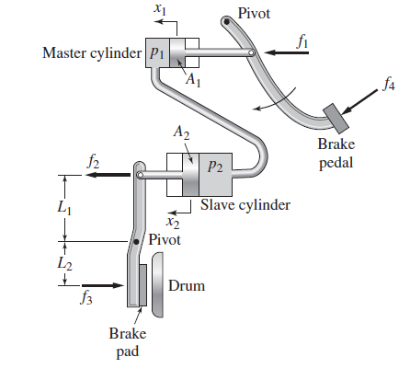
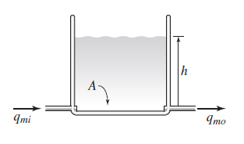
Static and dynamic systems
p₁= f₁/A₁ =p₂=f₂/A₂
f₂= (A₂/A₁)*f₁
f₂*L₁ = f₃*L₂
f₃= f₁* (A₂/A₁)* (L₁/L₂)
dh/dt α q_{mi} – q_{m0}

Slide 7
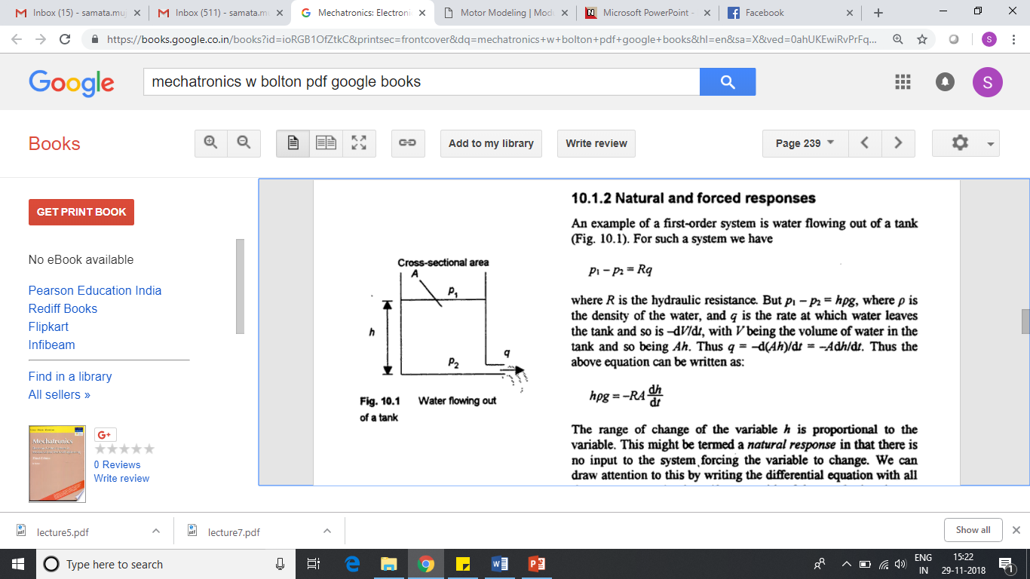
Static and dynamic systems

Slide 8
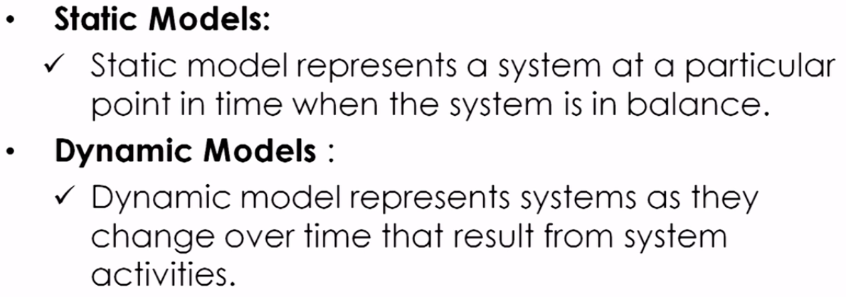
Static Vs Dynamic Systems

Slide 9
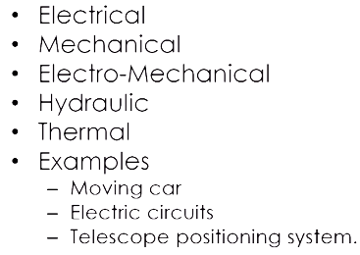
Dynamic Systems

Slide 10
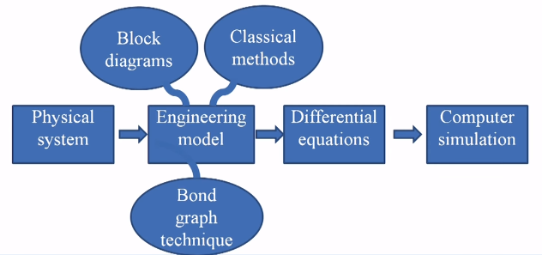
Design of dynamic systems

Slide 11
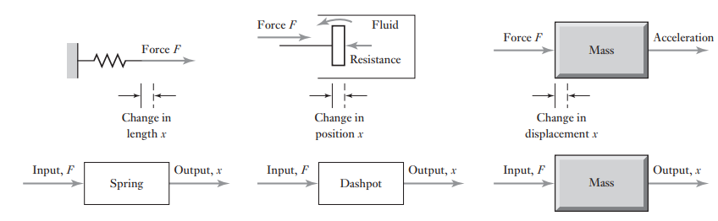
Mechanical systems
Stiffness
Friction or damping
Inertia
Springs represent the stiffness of a system
Dashpots the forces opposing motion, i.e. frictional or damping effects,
Masses the inertia or resistance to acceleration

Slide 12
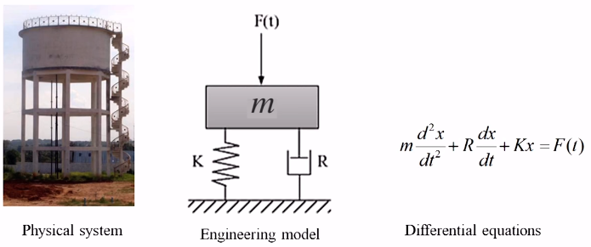
System Modelling

Slide 13
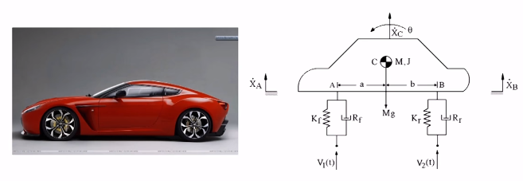
System Modelling

Slide 14
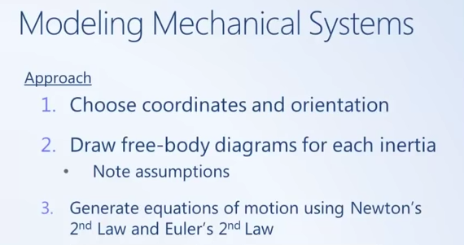
Mechanical systems
Each building block is considered to have a single property or function.

Slide 15
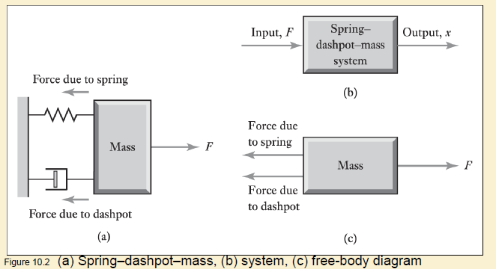
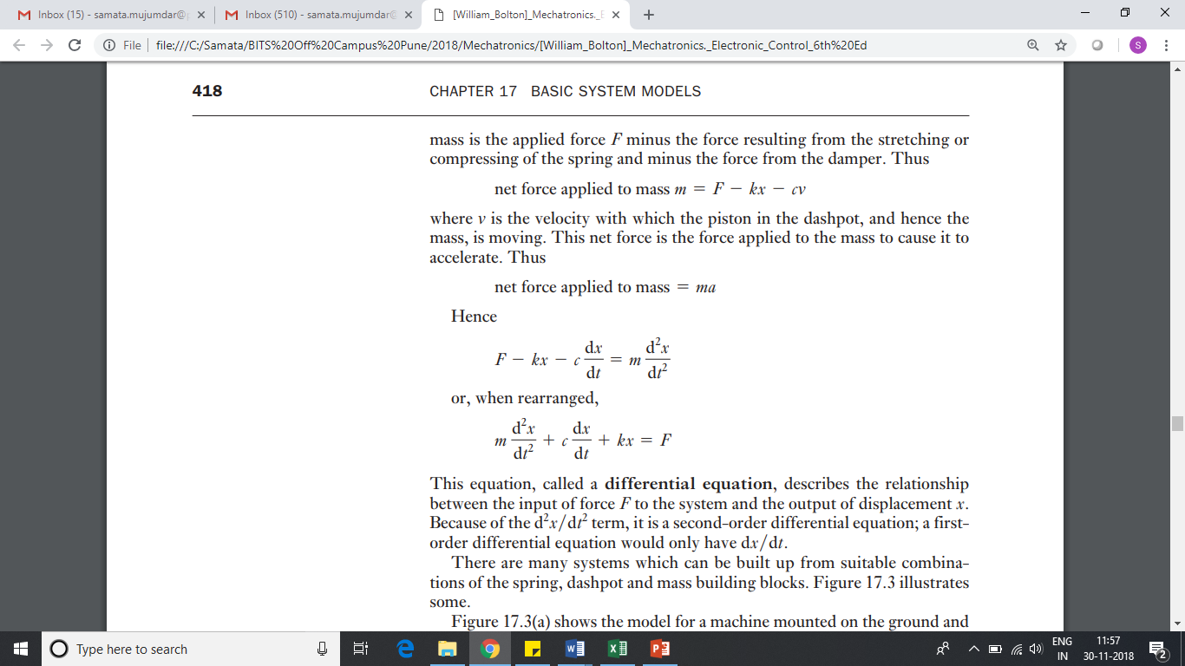
Mechanical systems - Linear

Slide 16
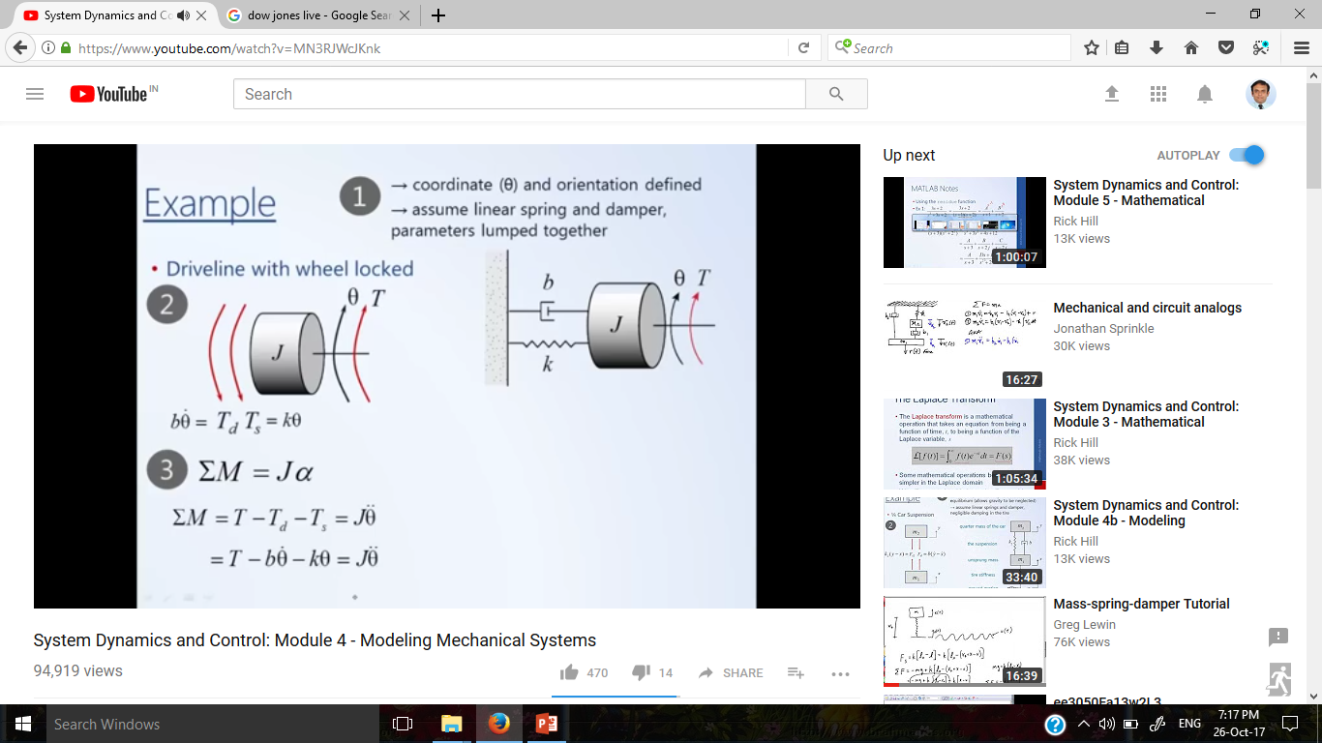
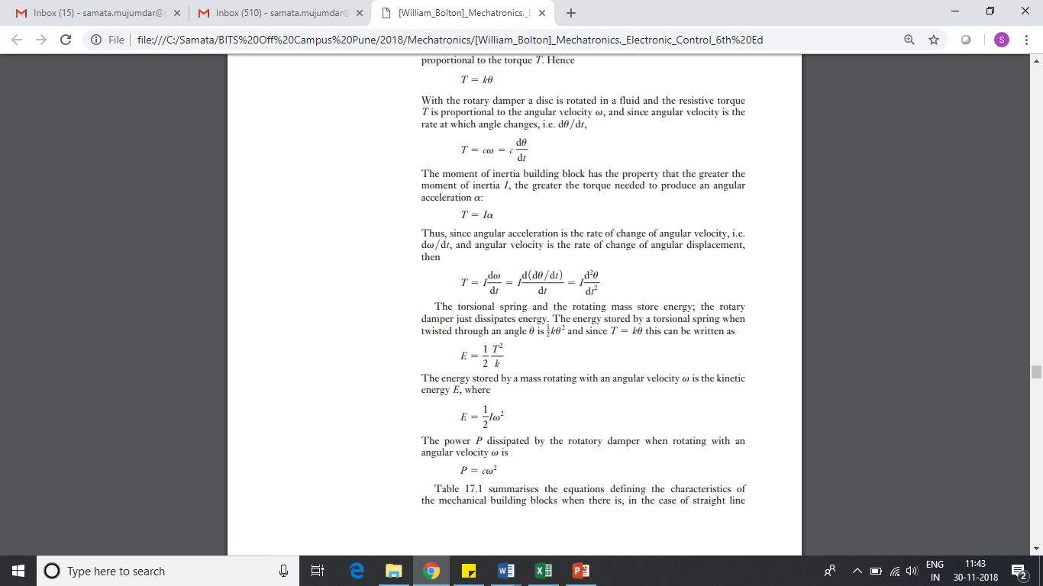
Rotational systems – Torsional spring, rotary damper and Moment of Inertia
I
I
Stiffness
Friction or damping
Inertia

Slide 17
Rotational systems – Torsional spring, rotary damper and Moment of Inertia
I

Slide 18
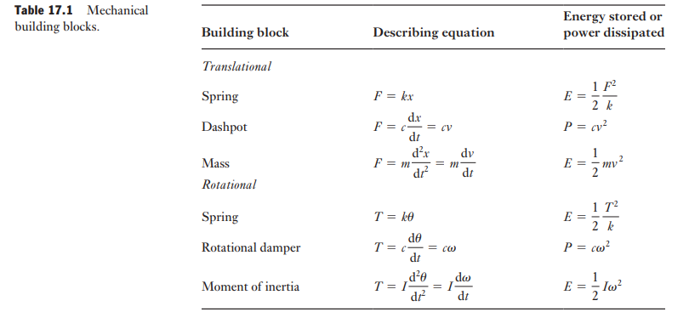
Mechanical Building blocks

Slide 19
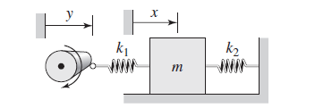
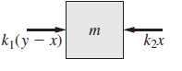
Spring Mass system

Slide 20
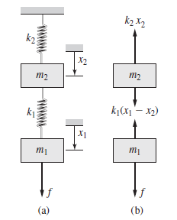
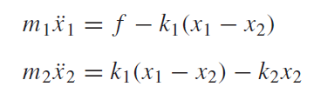
Spring Mass system

Slide 21
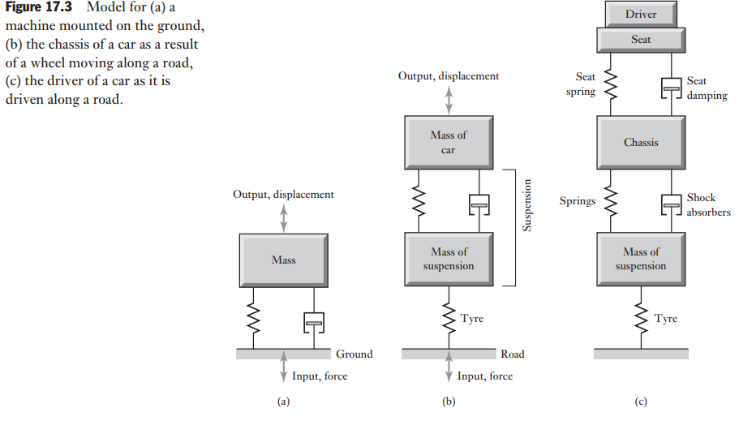
Mechanical systems – e.g.

Slide 22
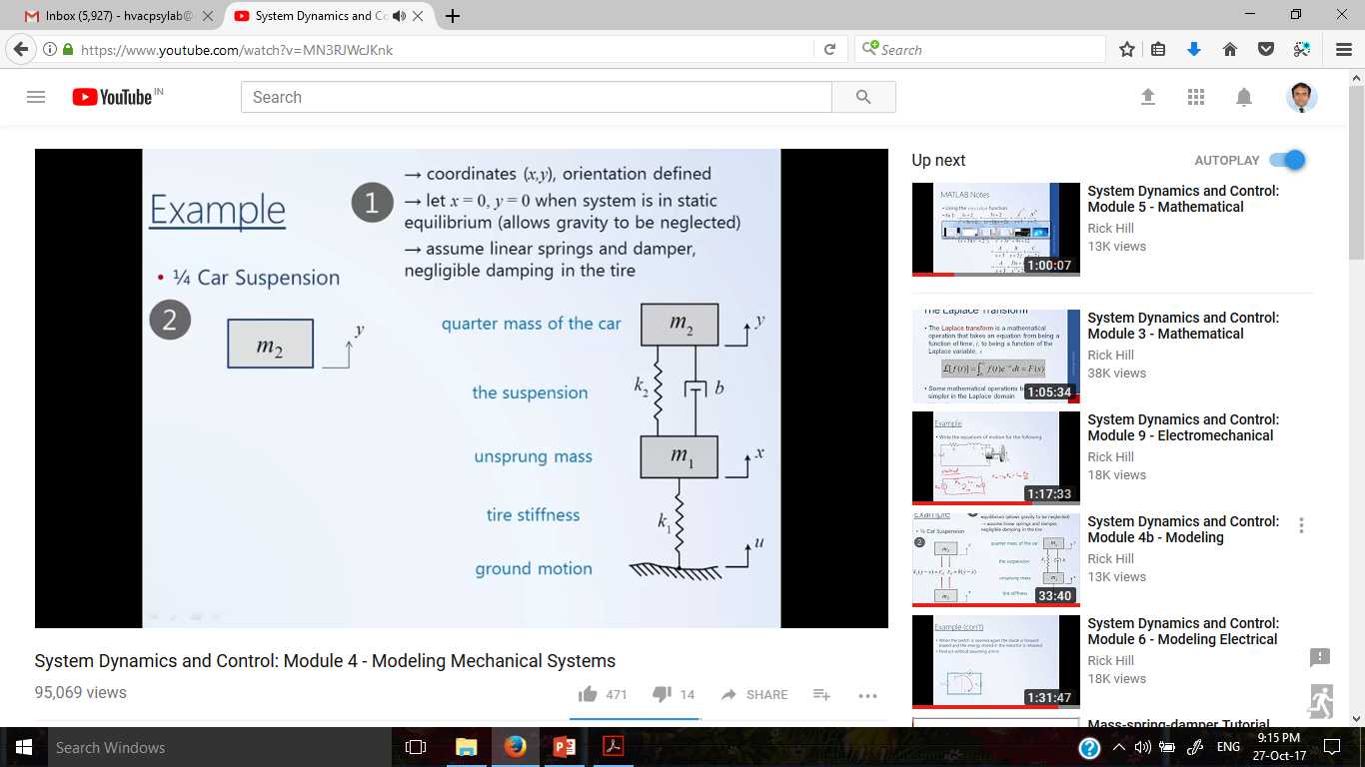
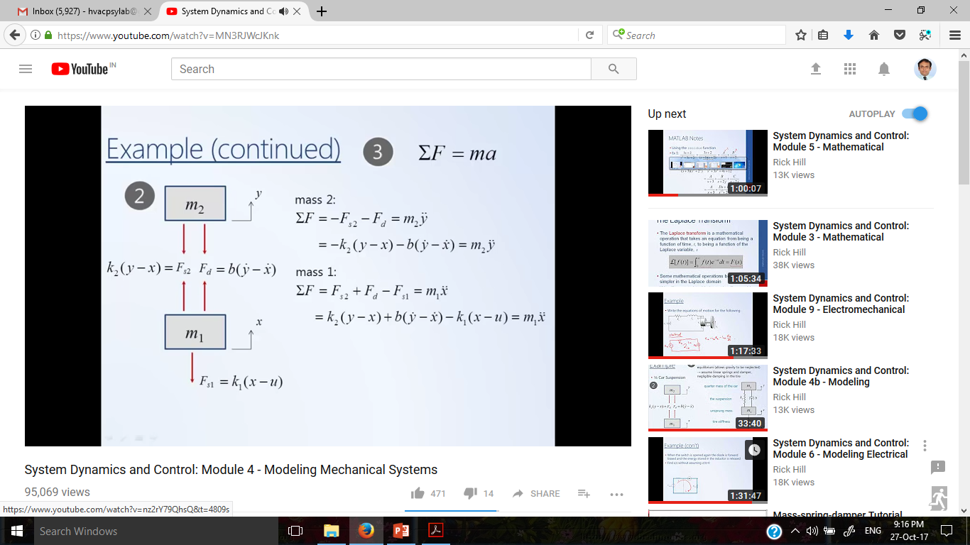
Quarter body

Slide 23
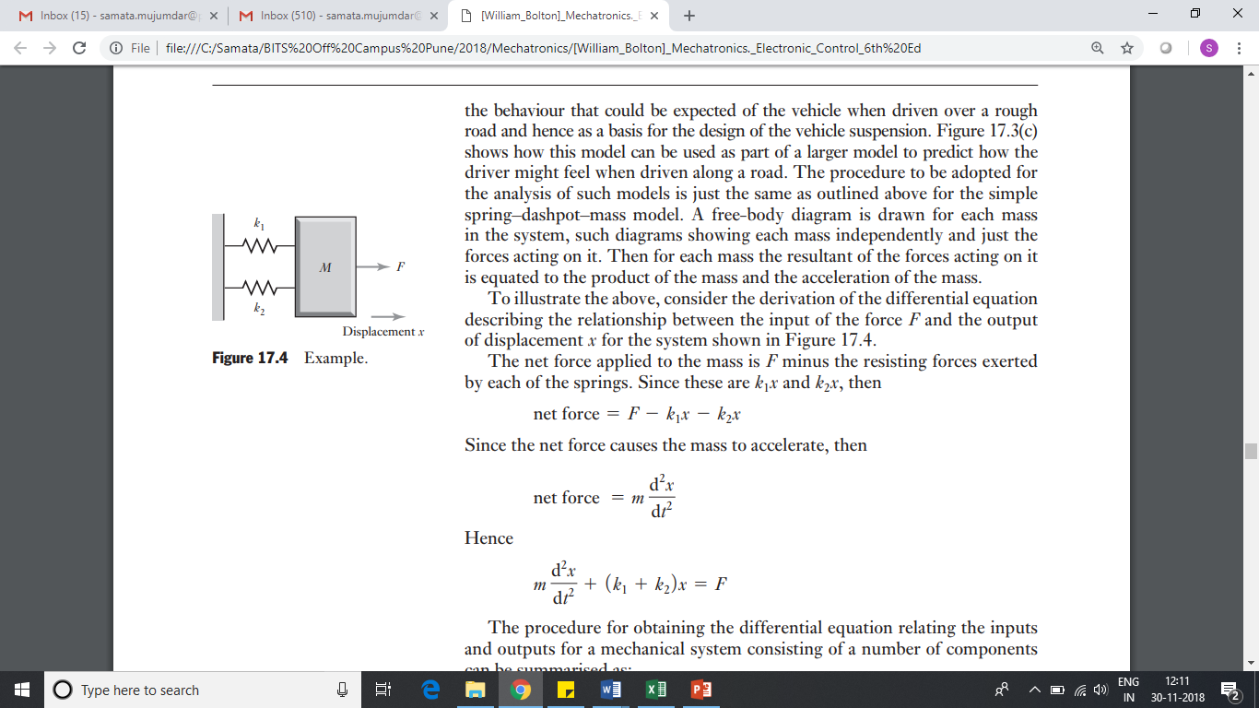
Springs in parallel

Slide 24
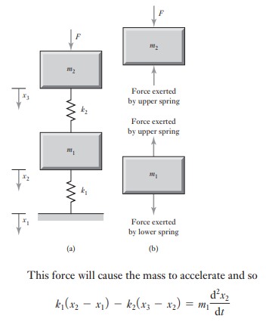
Mass Spring system

Slide 25
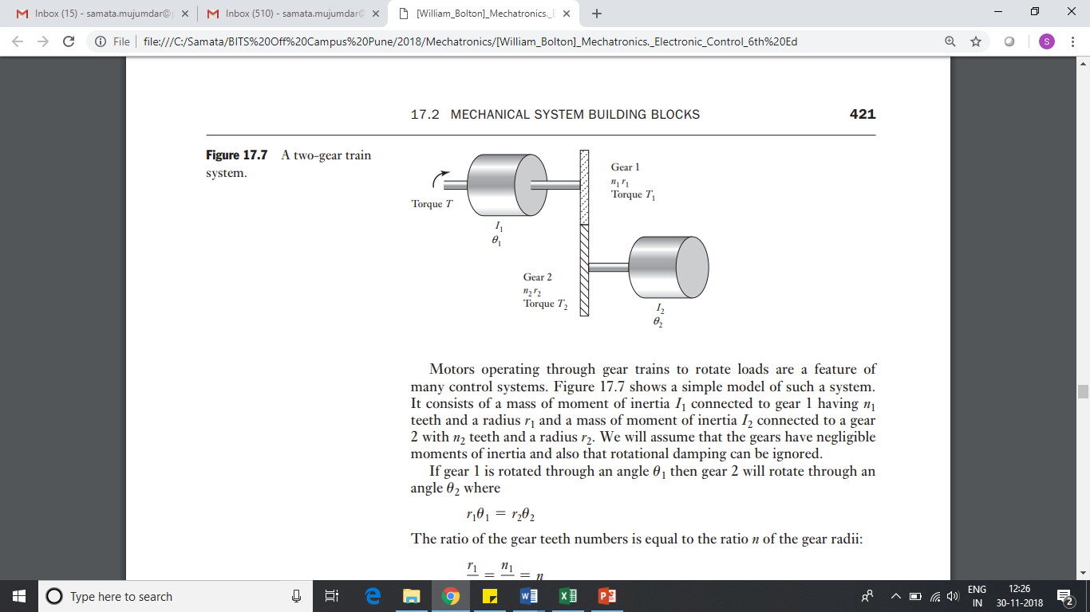
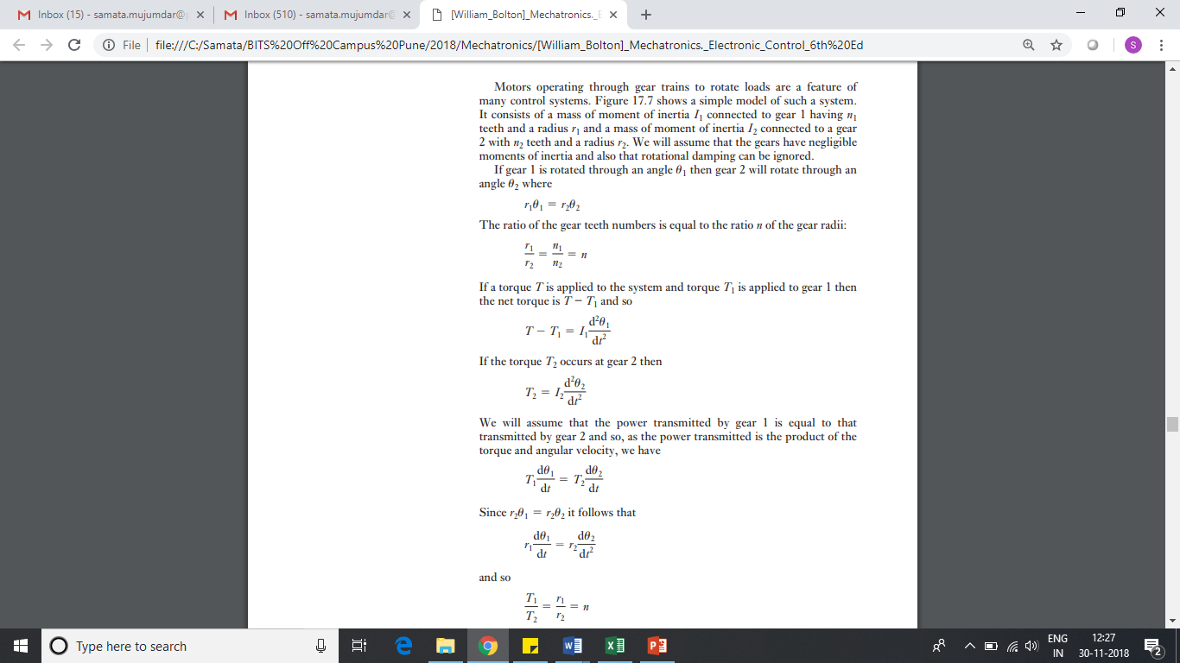
Two Gear train

Slide 26
Two Gear train
Printing mistake in book 6th edition

Slide 27
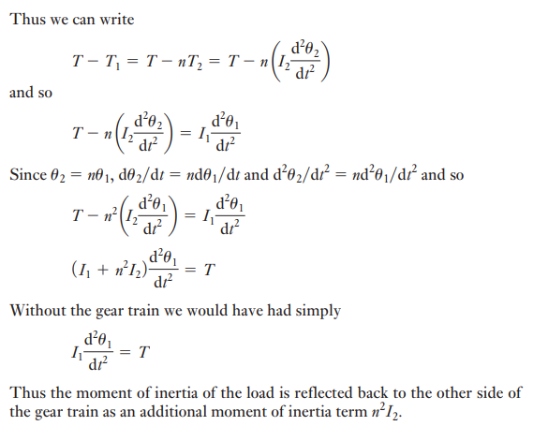
Two Gear train

Slide 28
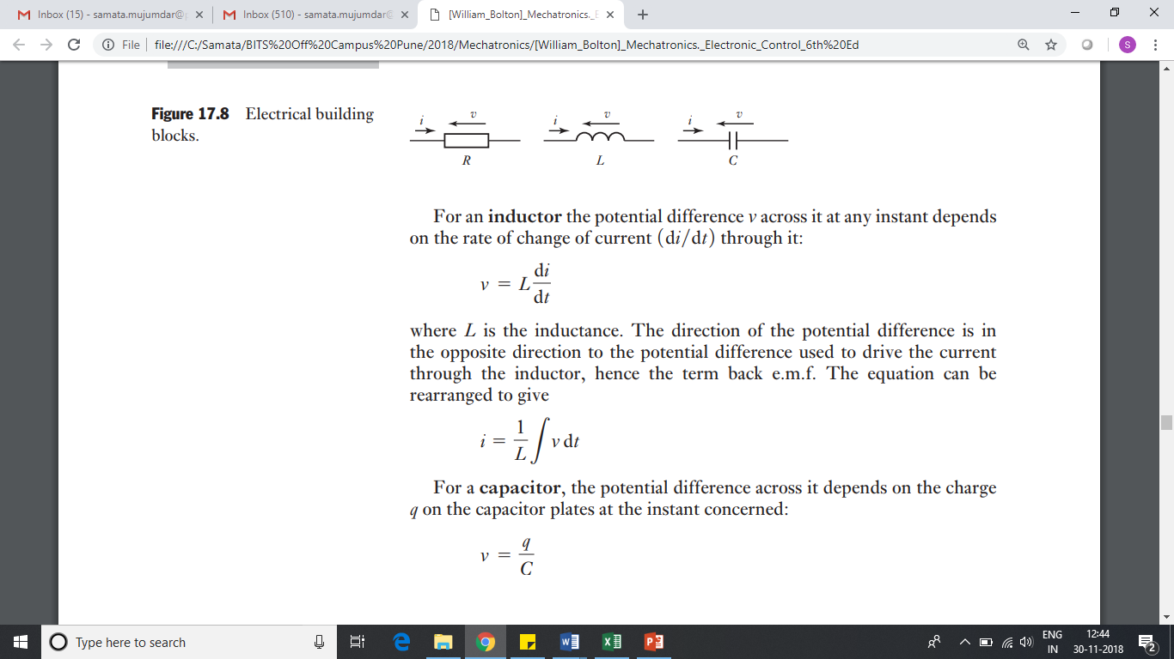
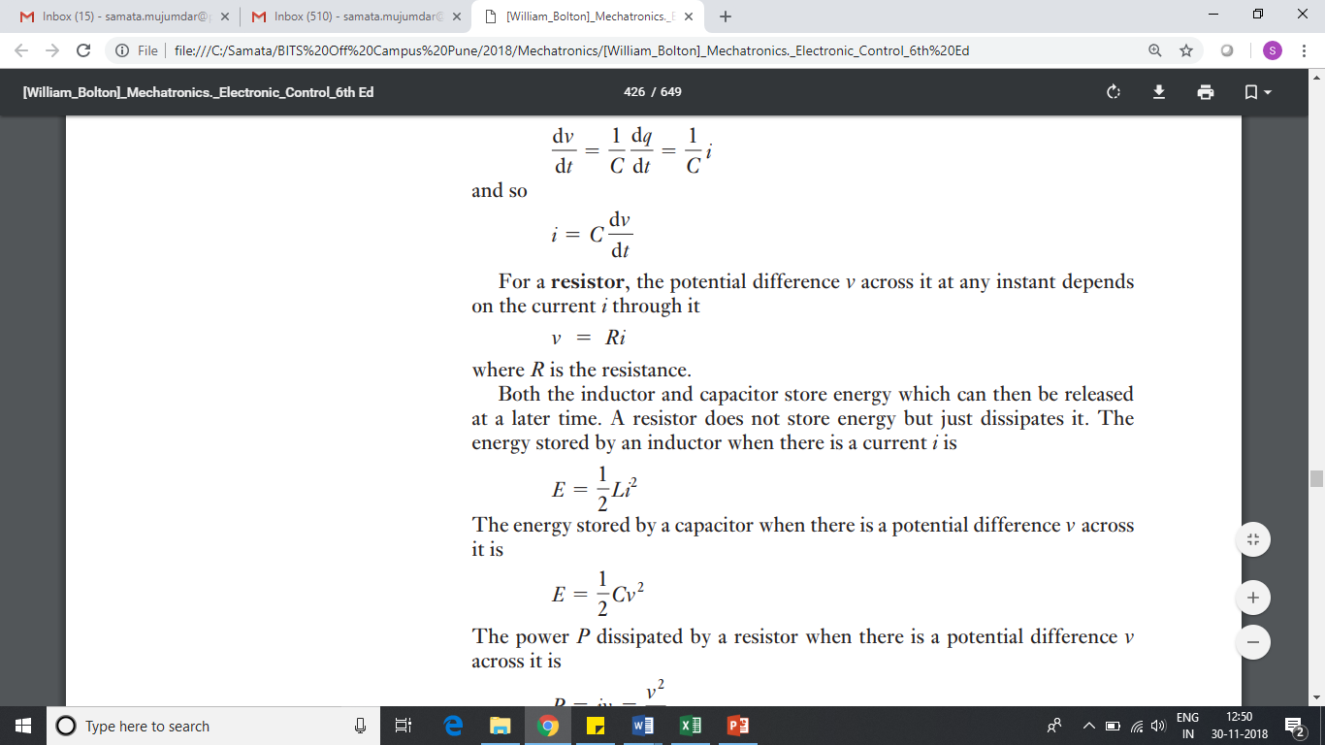
Electrical Systems building blocks

Slide 29
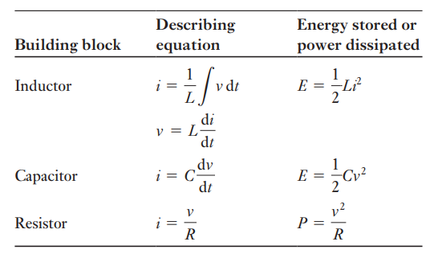
Electrical Systems building blocks

Slide 30
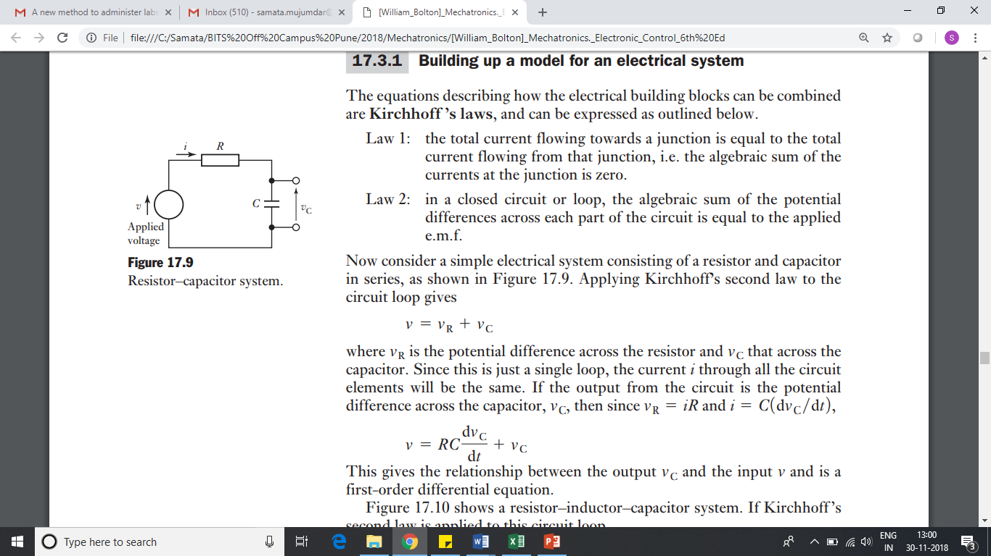
Electrical Systems- RC circuit
Vr = iR and i =C (dVc/dt)

Slide 31
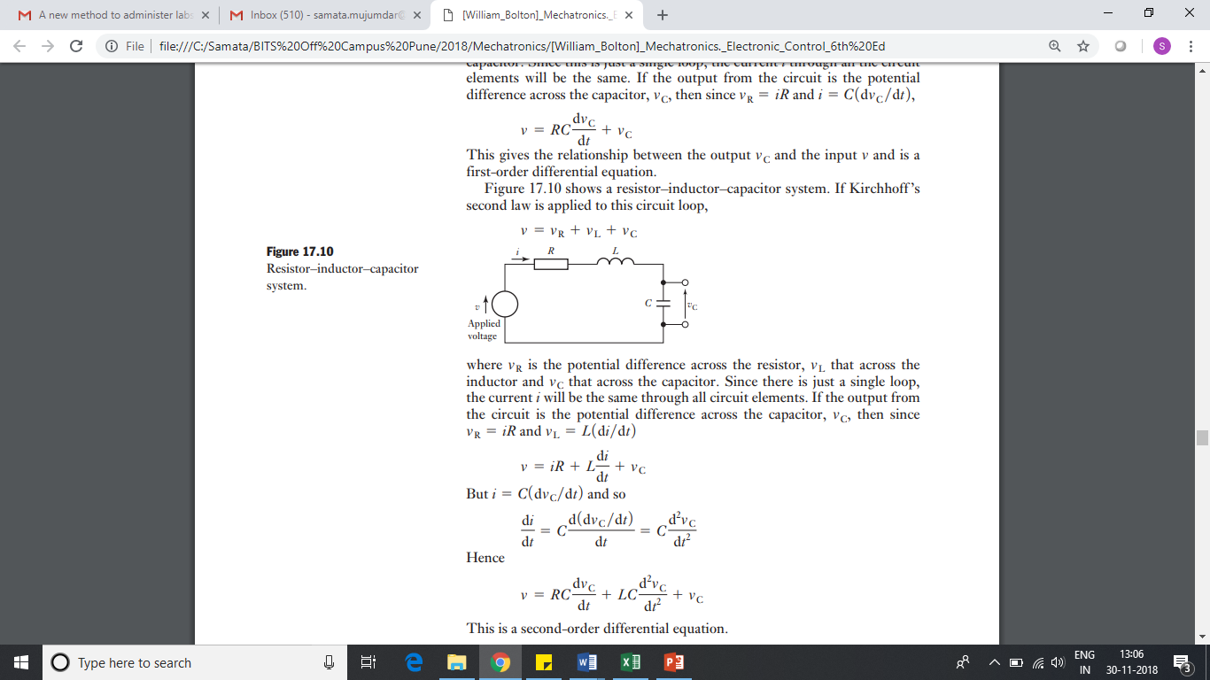
Electrical Systems- RCL circuit

Slide 32
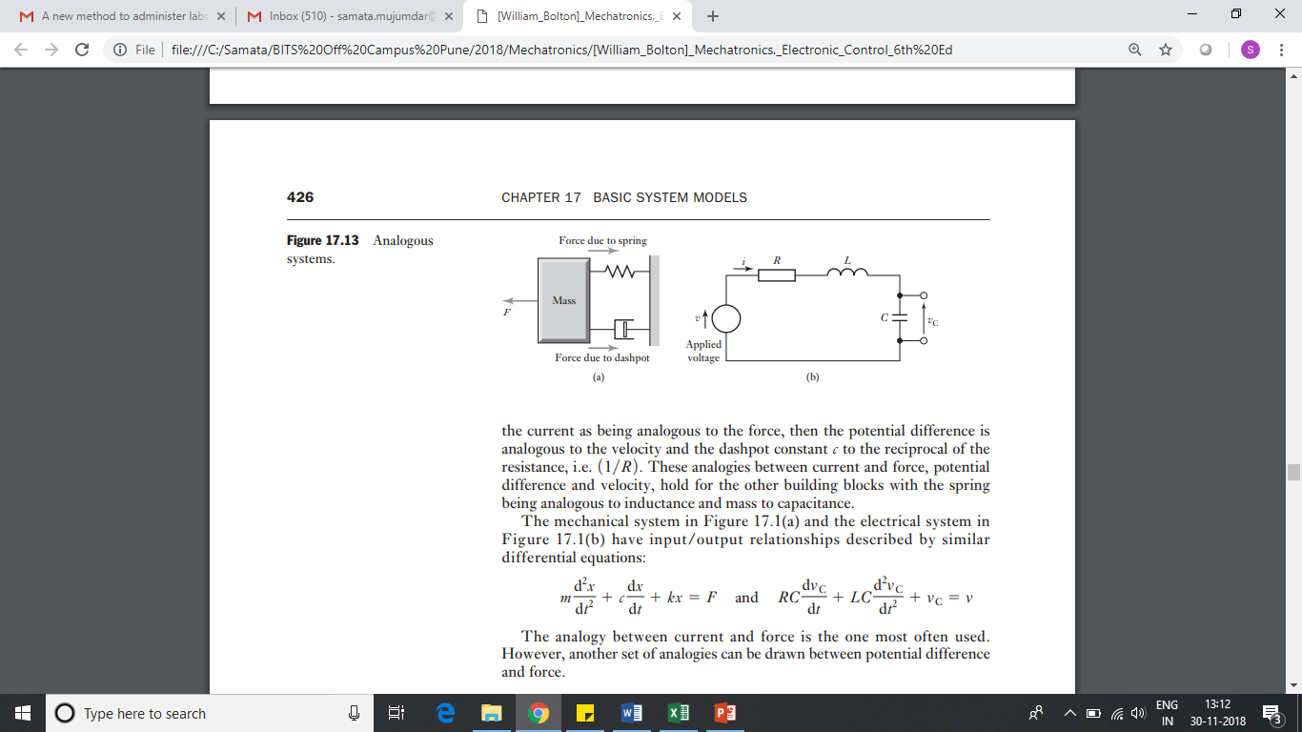
Electrical and mechanical analogies

Slide 33
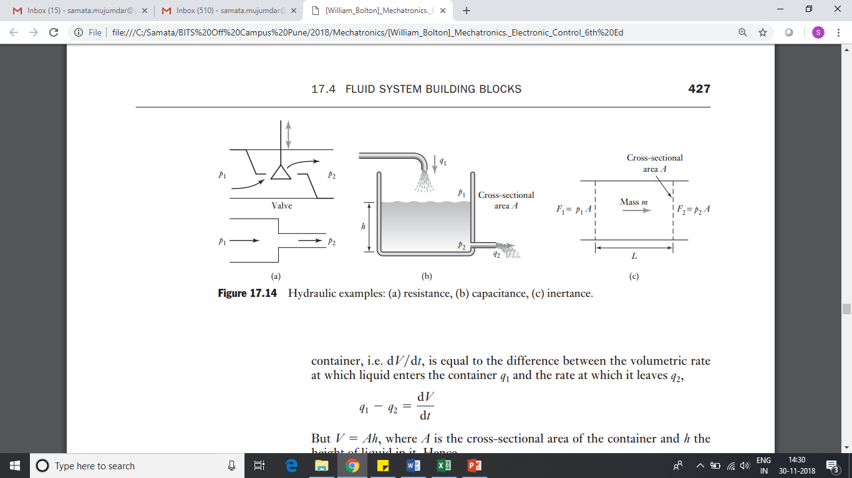
Fluid system building blocks- Hydraulic Résistance
Hydraulic Resistance
p1 - p2 = Rq
Ohm’s law
V = IR
Hydraulic resistance is the resistance to flow which occurs as a result of a liquid flowing through valves or changes in a pipe diameter

Slide 34
Hydraulic capacitance
Hydraulic Capacitance
q1 - q2 = dV /dt
q1 - q2 = A(dh /dt)
q1 - q2 = A/ƍg(dp /dt)
Hence , q1 - q2 = C(dp /dt)
pressure head, is one form of such a storage
Hydraulic capacitance is the term used to describe energy storage with a liquid where it is stored in the form of potential energy.

Slide 35
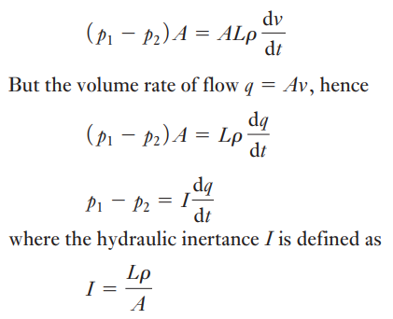
Hydraulic Inertance
Hydrulic inertance
F1-F2 = p1A-p2A
= A(p1-p2) = m(dV/dt)
equivalent of inductance in electrical systems
or a spring in mechanical systems
Inertance is a measure of the pressure difference in a fluid required to cause a unit change in the rate of change of volumetric flow-rate with time.

Slide 36
Thermal system building blocks
Building blocks for thermal system
Thermal Resistance
Thermal Capacitance

Slide 37
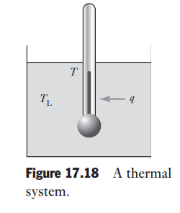
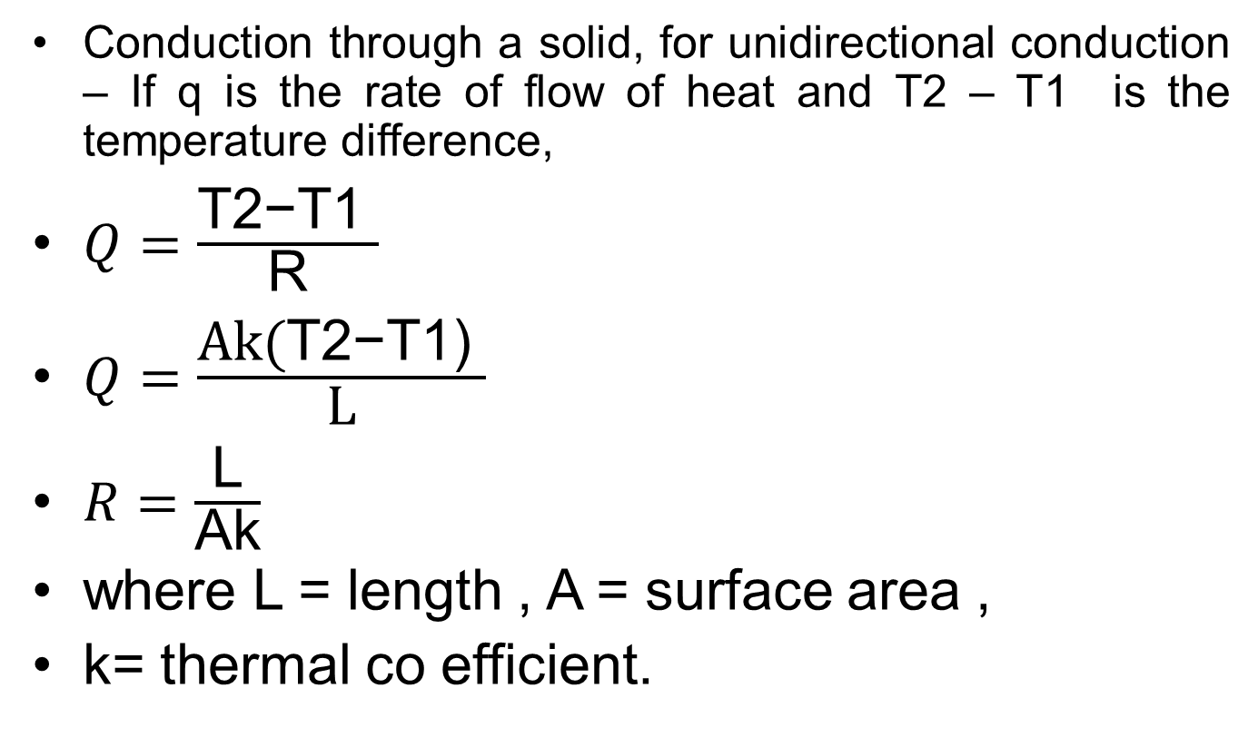
Thermal system building blocks
Conduction through a solid, for unidirectional conduction – If q is the rate of flow of heat and T2 – T1 is the temperature difference,
$Q=\frac{\text{T}\text{2}\text{−}\text{T}\text{1} }{\text{R}}$
$Q=\frac{\text{Ak}\text{(}\text{T}\text{2−}\text{T}\text{1) }}{\text{L}}$
$R=\frac{\text{L}}{\text{Ak}}$
where L = length , A = surface area ,
k= thermal co efficient.

Slide 38
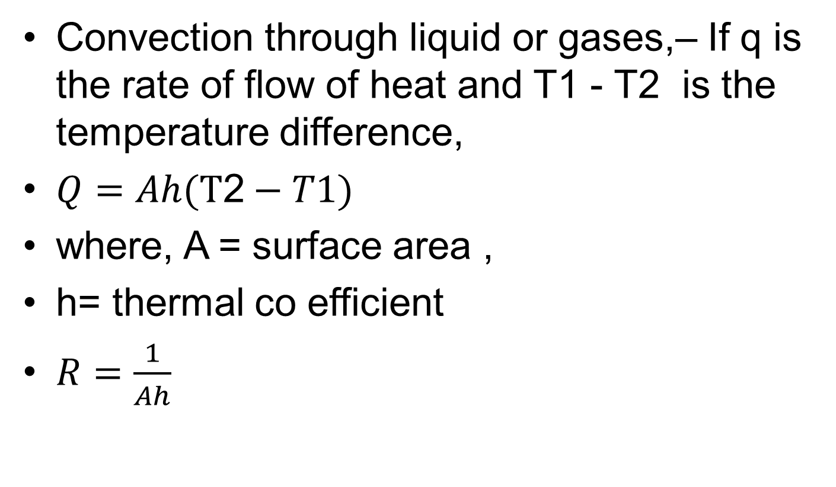
Thermal system building blocks
Convection through liquid or gases,– If q is the rate of flow of heat and T1 - T2 is the temperature difference,
$Q=Ah(\text{T}\text{2}−T1)$
where, A = surface area ,
h= thermal co efficient
$R=\frac{1}{Ah}$

Slide 39
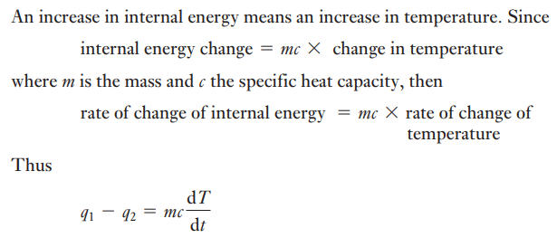
Thermal system building blocks
Thermal Capacitance ,
rate of change of internal energy = q1-q2

Slide 40
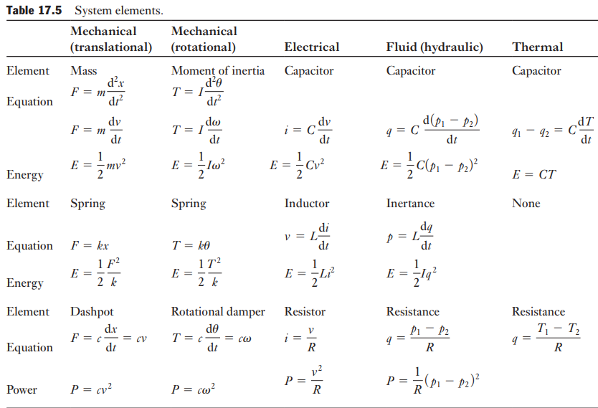
Summary

Slide 41
Thank you

